Slide 1

Least Squares
MATH674
Lizzy Eccles, Mingyu Huang, and Veronika Titarchuk
L

Slide 2
Responsibilities
Veronika is the code master
We trust any decisions you make
Lizzy does background
Lizzy and Veronika combine to do application with actual dataset
Mingyu checks to see if we did a good job. Captain Mingyu!

Slide 3
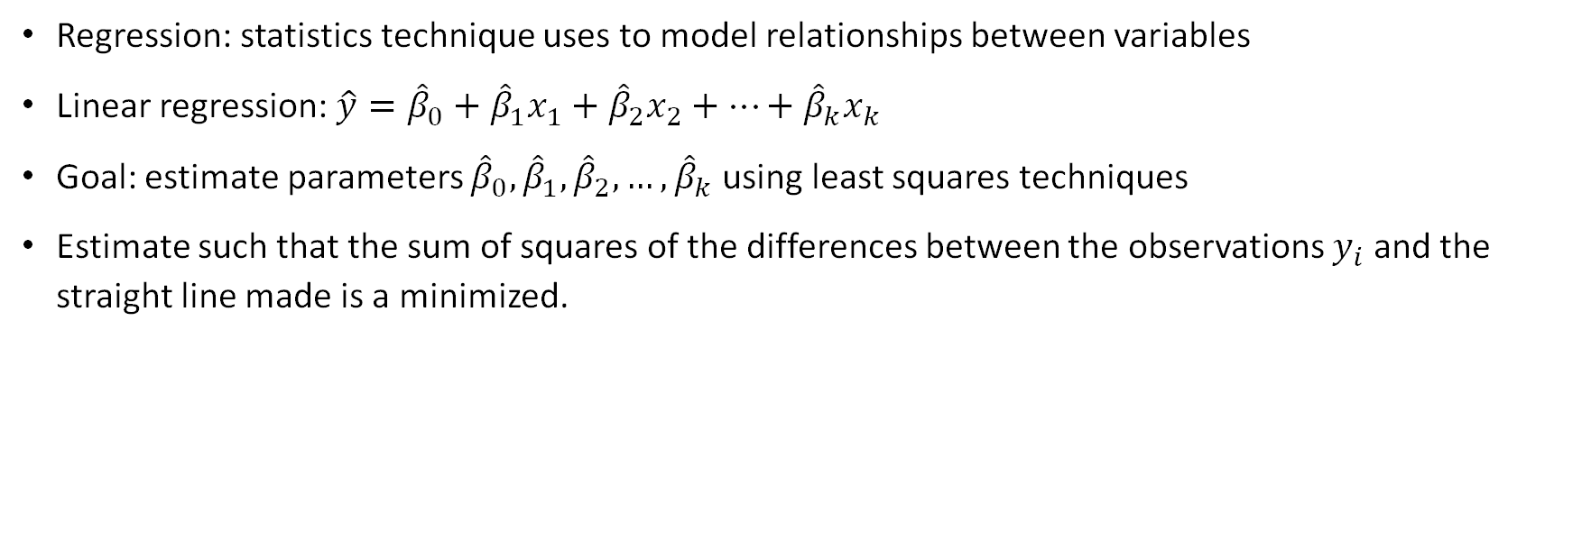
Introduction
Regression: statistics technique uses to model relationships between variables
Linear regression: $\hat{y}={\hat{β}}_{0}+{\hat{β}}_{1}x_{1}+{\hat{β}}_{2}x_{2}+…+{\hat{β}}_{k}x_{k}$
Goal: estimate parameters ${\hat{β}}_{0},{\hat{β}}_{1},{\hat{β}}_{2},…,{\hat{β}}_{k}$ using least squares techniques
Estimate such that the sum of squares of the differences between the observations $y_{i}$ and the straight line made is a minimized.
L

Slide 4
Techniques
Least Squares
Simple Linear Regression
Multiple Linear Regression
Geometric Interpretation
Special Case of Orthogonal Columns
Generalized Inverse
Generalized Least Squares
Condition Numbers
Stability
L

Slide 5
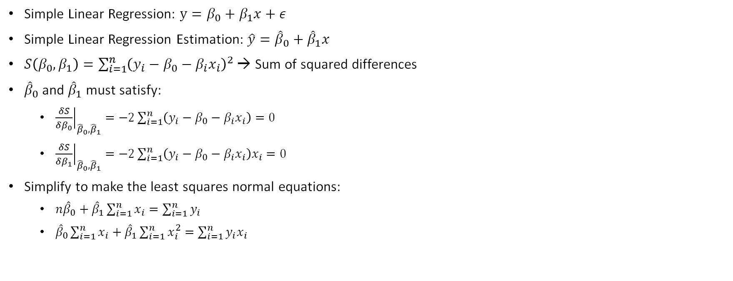
Least squares criterion for simple linear regression
Simple Linear Regression: $y=β_{0}+β_{1}x+ε$
Simple Linear Regression Estimation: $\hat{y}={\hat{β}}_{0}+{\hat{β}}_{1}x$
$S\left(β_{0},β_{1}\right)=\sum_{i=1}^{n}{{\left(y_{i}−β_{0}−β_{i}x_{i}\right)}^{2}}$ → Sum of squared differences
${\hat{β}}_{0}$ and ${\hat{β}}_{1}$ must satisfy:
${\left.\frac{δS}{δβ_{0}}\right|}_{{\hat{β}}_{0},{\hat{β}}_{1}}=−2\sum_{i=1}^{n}{\left(y_{i}−β_{0}−β_{i}x_{i}\right)}=0$
${\left.\frac{δS}{δβ_{1}}\right|}_{{\hat{β}}_{0},{\hat{β}}_{1}}=−2\sum_{i=1}^{n}{\left(y_{i}−β_{0}−β_{i}x_{i}\right)x_{i}}=0$
Simplify to make the least squares normal equations:
$n{\hat{β}}_{0}+{\hat{β}}_{1}\sum_{i=1}^{n}{x_{i}}=\sum_{i=1}^{n}{y_{i}}$
${\hat{β}}_{0}\sum_{i=1}^{n}{x_{i}}+{\hat{β}}_{1}\sum_{i=1}^{n}{x_{i}^{2}}=\sum_{i=1}^{n}{y_{i}x_{i}}$
L

Slide 6

Least squares normal equations for simple linear regression
Solution to the normal equations:
${\hat{β}}_{0}=\overline{y}−{\hat{β}}_{1}\overline{x}$
${\hat{β}}_{1}=\frac{\sum_{i=1}^{n}{y_{i}x_{i}−\frac{(\sum_{i=1}^{n}{y_{i})}(\sum_{i=1}^{n}{x_{i})}}{n}}}{\sum_{i=1}^{n}{x_{i}^{2}}−\frac{{\left(\sum_{i=1}^{n}{x_{i}^{2}}\right)}^{2}}{n}}=\frac{S_{xy}}{S_{xx}}$
Where $\overline{y}=\frac{1}{n}\sum_{i=1}^{n}{y_{i}}$ and $\overline{x}=\frac{1}{n}\sum_{i=1}^{n}{x_{i}}$
L

Slide 7
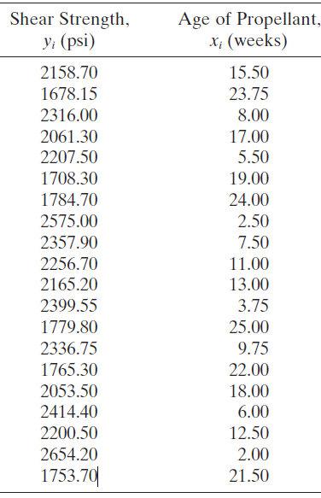
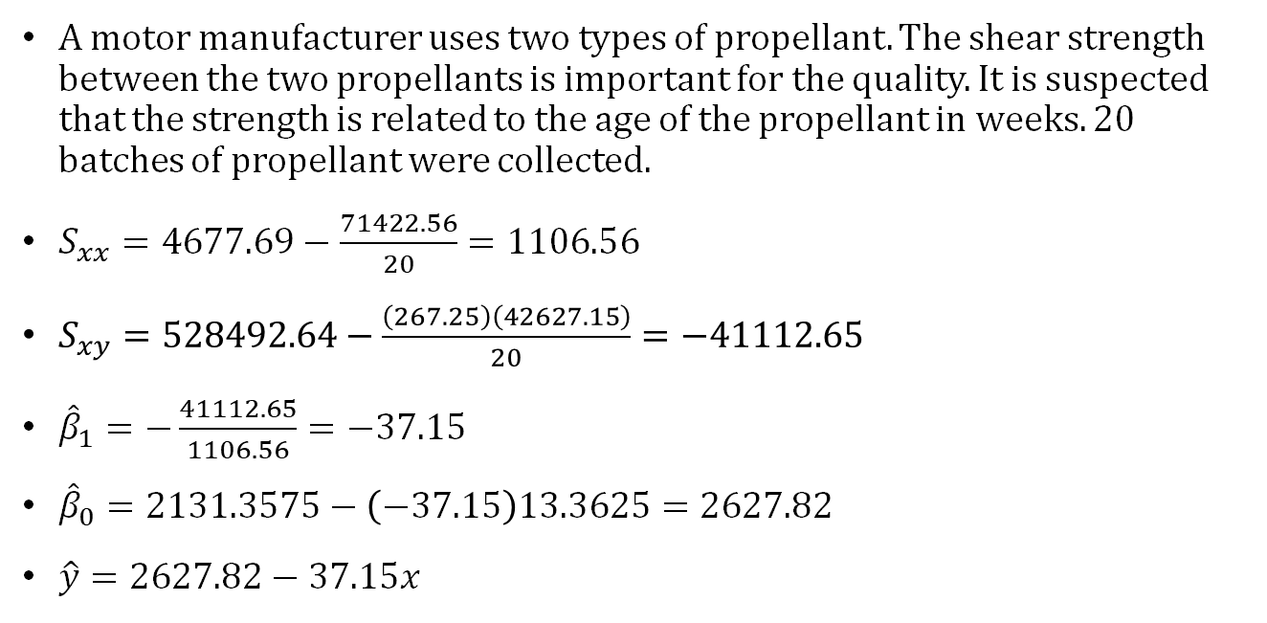
Least Squares simple linear regression example
A motor manufacturer uses two types of propellant. The shear strength between the two propellants is important for the quality. It is suspected that the strength is related to the age of the propellant in weeks. 20 batches of propellant were collected.
$S_{xx}=4677.69−\frac{71422.56}{20}=1106.56$
$S_{xy}=528492.64−\frac{\left(267.25\right)\left(42627.15\right)}{20}=−41112.65$
${\hat{β}}_{1}=−\frac{41112.65}{1106.56}=−37.15$
${\hat{β}}_{0}=2131.3575−\left(−37.15\right)13.3625=2627.82$
$\hat{y}=2627.82−37.15x$
V

Slide 8
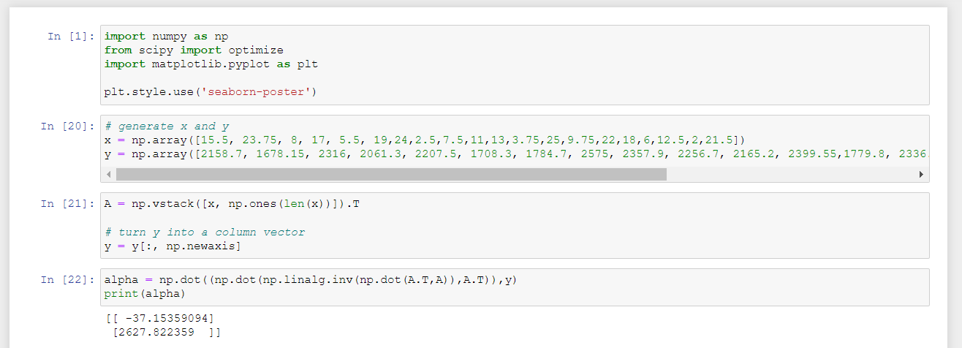
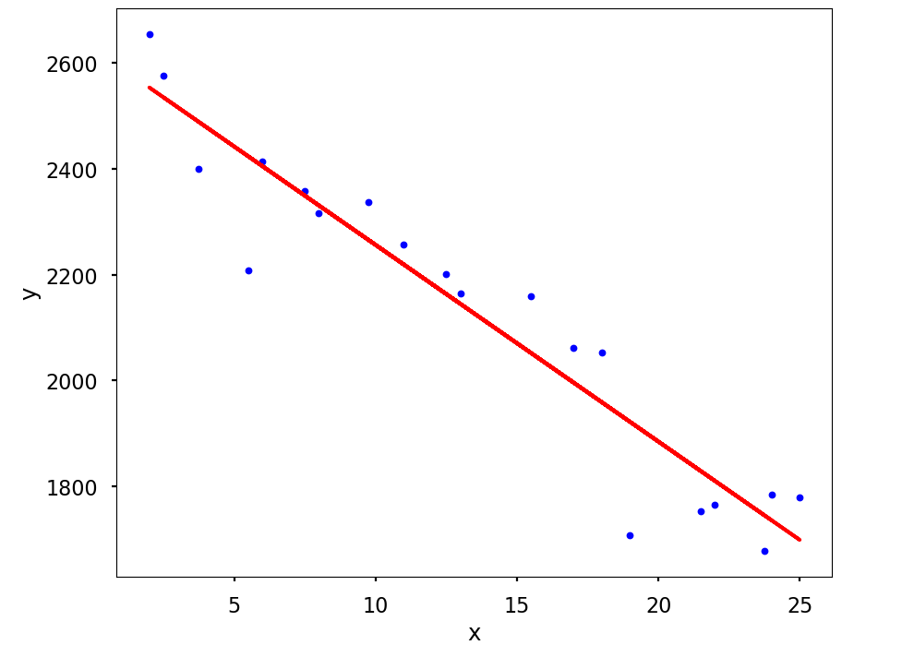
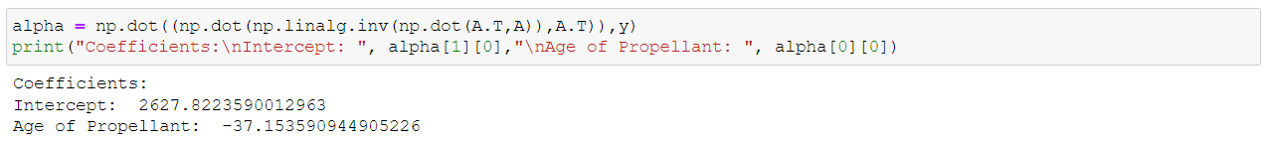
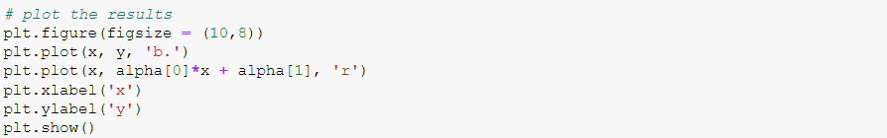

Python Code
$$\hat{y}=2627.82−37.154x$$
V

Slide 9
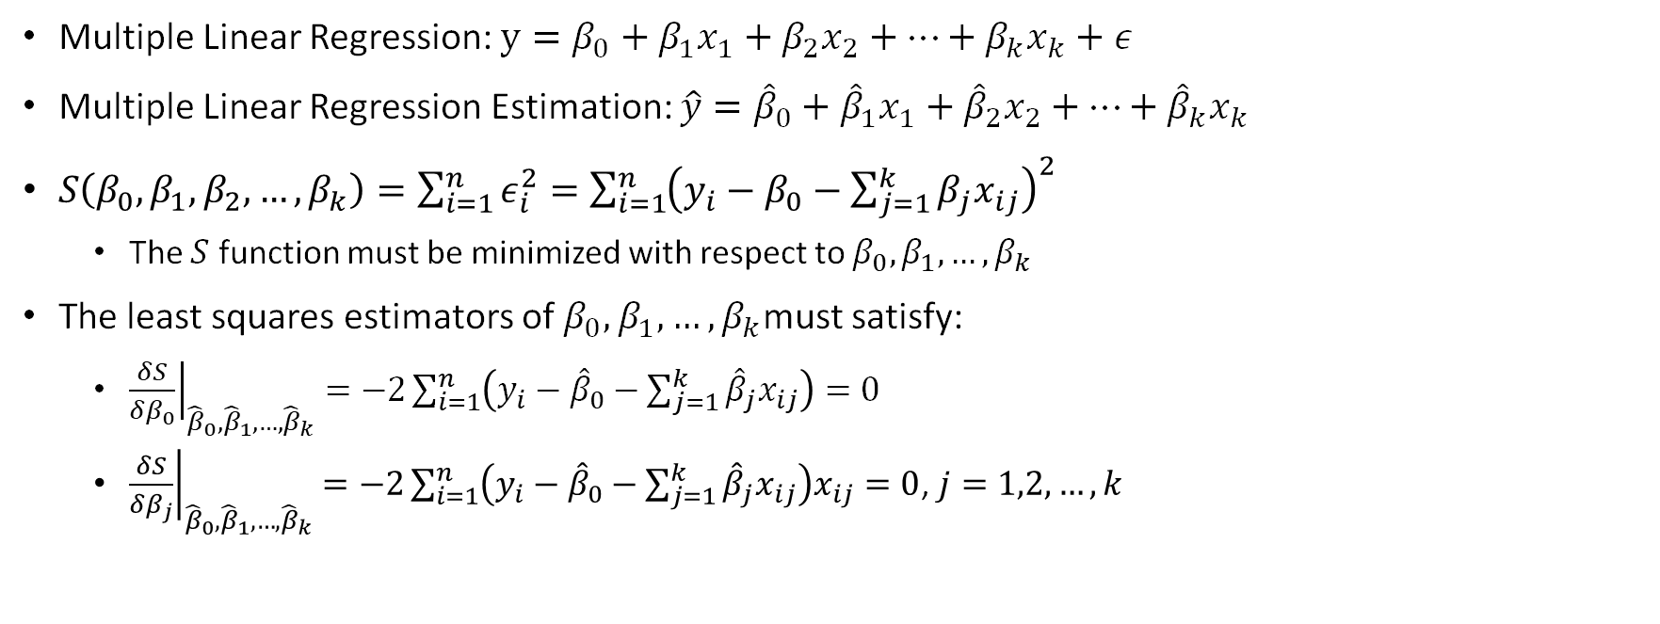
Least squares criterion for MULTIPLE linear regression
Multiple Linear Regression: $y=β_{0}+β_{1}x_{1}+β_{2}x_{2}+…+β_{k}x_{k}+ε$
Multiple Linear Regression Estimation: $\hat{y}={\hat{β}}_{0}+{\hat{β}}_{1}x_{1}+{\hat{β}}_{2}x_{2}+…+{\hat{β}}_{k}x_{k}$
$S\left(β_{0},β_{1},β_{2},…,β_{k}\right)=\sum_{i=1}^{n}{ε_{i}^{2}}=\sum_{i=1}^{n}{{\left(y_{i}−β_{0}−\sum_{j=1}^{k}{β_{j}x_{ij}}\right)}^{2}}$
The $S$ function must be minimized with respect to $β_{0},β_{1},…,β_{k}$
The least squares estimators of $β_{0},β_{1},…,β_{k}$must satisfy:
${\left.\frac{δS}{δβ_{0}}\right|}_{{\hat{β}}_{0},{\hat{β}}_{1},…,{\hat{β}}_{k}}=−2\sum_{i=1}^{n}{\left(y_{i}−{\hat{β}}_{0}−\sum_{j=1}^{k}{{\hat{β}}_{j}x_{ij}}\right)}=0$
${\left.\frac{δS}{δβ_{j}}\right|}_{{\hat{β}}_{0},{\hat{β}}_{1},…,{\hat{β}}_{k}}=−2\sum_{i=1}^{n}{\left(y_{i}−{\hat{β}}_{0}−\sum_{j=1}^{k}{{\hat{β}}_{j}x_{ij}}\right)x_{ij}}=0$, $j=1,2,…,k$
L

Slide 10
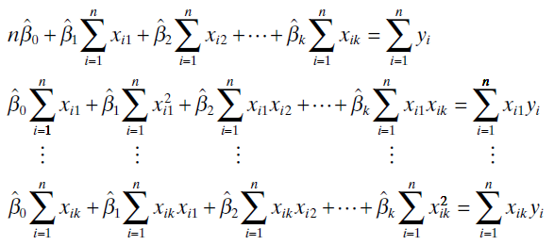
Least squares normal equations for multiple linear regression
Solution to normal equations:
L

Slide 11

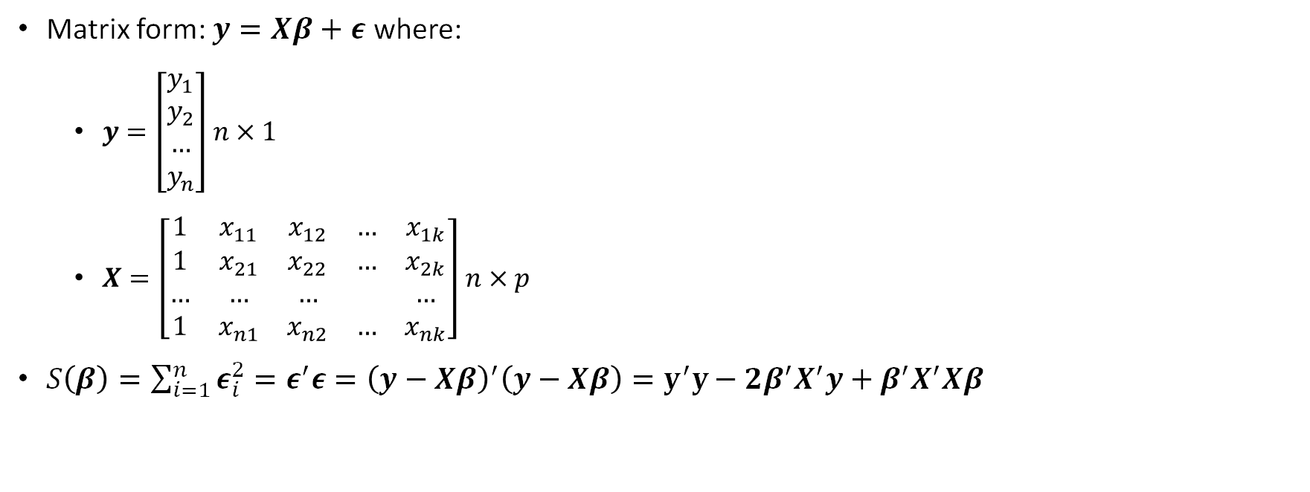
Least squares normal equations for multiple linear regression cont.
Matrix form: $y=Xβ+ε$ where:
$y=\left[\begin{matrix}y_{1} \\ y_{2} \\ … \\ y_{n}\end{matrix}\right]$ $n×1$
$X=\left[\begin{matrix}1 & x_{11} & x_{12} & … & x_{1k} \\ 1 & x_{21} & x_{22} & … & x_{2k} \\ … & … & … & & … \\ 1 & x_{n1} & x_{n2} & … & x_{nk}\end{matrix}\right]$ $n×p$
$S\left(β\right)=\sum_{i=1}^{n}{ε_{i}^{2}}=ε^{′}ε={\left(y−Xβ\right)}^{′}\left(y−Xβ\right)=y^{′}y−2β^{′}X^{′}y+β^{′}X^{′}Xβ$
$β=\left[\begin{matrix}β_{1} \\ β_{2} \\ … \\ β_{k}\end{matrix}\right]$ $p×1$
$ε=\left[\begin{matrix}ε_{1} \\ ε_{2} \\ … \\ ε_{n}\end{matrix}\right]$ $n×1$
L

Slide 12
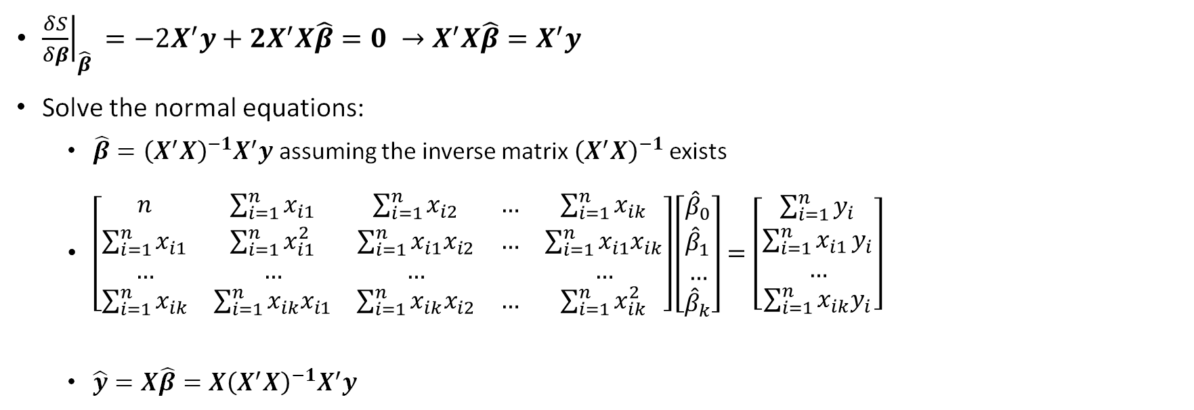
Least squares normal equations for multiple linear regression cont.
${\left.\frac{δS}{δβ}\right|}_{\hat{β} }=−2X^{′}y+2X^{′}X\hat{β}=0 →X^{′}X\hat{β}=X^{′}y$
Solve the normal equations:
$\hat{β}={\left(X^{′}X\right)}^{−1}X^{′}y$ assuming the inverse matrix ${\left(X^{′}X\right)}^{−1}$ exists
$\left[\begin{matrix}n & \sum_{i=1}^{n}{x_{i1}} & \sum_{i=1}^{n}{x_{i2}} & … & \sum_{i=1}^{n}{x_{ik}} \\ \sum_{i=1}^{n}{x_{i1}} & \sum_{i=1}^{n}{x_{i1}^{2}} & \sum_{i=1}^{n}{x_{i1}x_{i2}} & … & \sum_{i=1}^{n}{x_{i1}x_{ik}} \\ … & … & … & & … \\ \sum_{i=1}^{n}{x_{ik}} & \sum_{i=1}^{n}{x_{ik}x_{i1}} & \sum_{i=1}^{n}{x_{ik}x_{i2}} & … & \sum_{i=1}^{n}{x_{ik}^{2}}\end{matrix}\right]\left[\begin{matrix}{\hat{β}}_{0} \\ {\hat{β}}_{1} \\ … \\ {\hat{β}}_{k}\end{matrix}\right]=\left[\begin{matrix}\sum_{i=1}^{n}{y_{i}} \\ \sum_{i=1}^{n}{x_{i1}}y_{i} \\ … \\ \sum_{i=1}^{n}{x_{ik}y_{i}}\end{matrix}\right]$
$\hat{y}=X\hat{β}=X{\left(X^{′}X\right)}^{−1}X^{′}y$
L

Slide 13
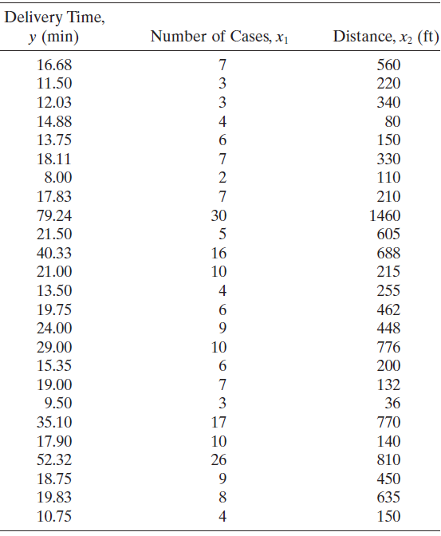
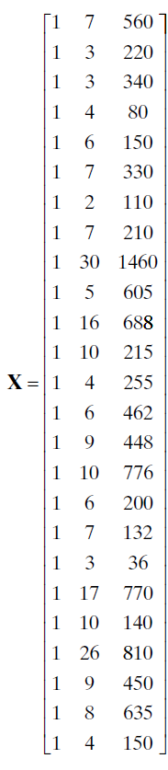
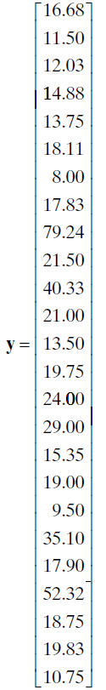
Least Squares multiple linear regression example
V

Slide 14
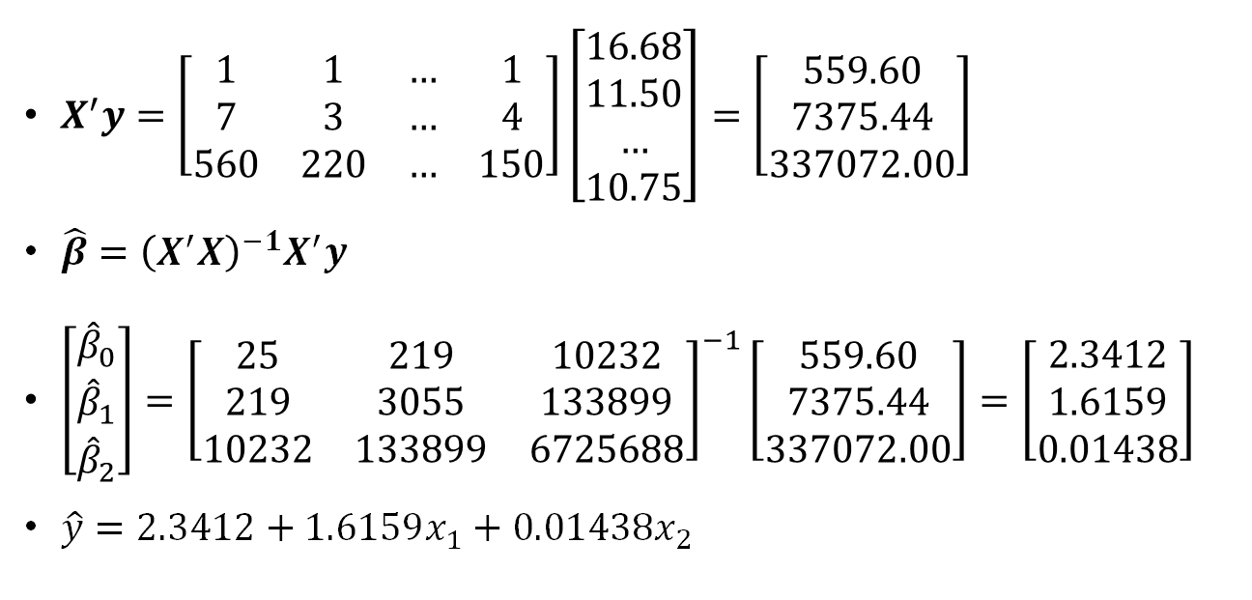
Least Squares multiple linear regression example
$X^{′}y=\left[\begin{matrix}1 & 1 & … & 1 \\ 7 & 3 & … & 4 \\ 560 & 220 & … & 150\end{matrix}\right]\left[\begin{matrix}16.68 \\ 11.50 \\ … \\ 10.75\end{matrix}\right]=\left[\begin{matrix}559.60 \\ 7375.44 \\ 337072.00\end{matrix}\right]$
$\hat{β}={\left(X^{′}X\right)}^{−1}X^{′}y$
$\left[\begin{matrix}{\hat{β}}_{0} \\ {\hat{β}}_{1} \\ {\hat{β}}_{2}\end{matrix}\right]={\left[\begin{matrix}25 & 219 & 10232 \\ 219 & 3055 & 133899 \\ 10232 & 133899 & 6725688\end{matrix}\right]}^{−1}\left[\begin{matrix}559.60 \\ 7375.44 \\ 337072.00\end{matrix}\right]=\left[\begin{matrix}2.3412 \\ 1.6159 \\ 0.01438\end{matrix}\right]$
$\hat{y}=2.3412+1.6159x_{1}+0.01438x_{2}$
V

Slide 15
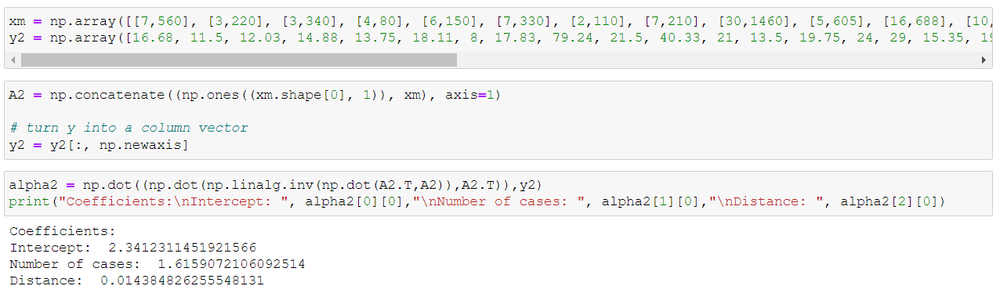

Python Code
$$\hat{y}=2.341+1.6159x_{1}+0.0144x_{2}$$
V

Slide 16
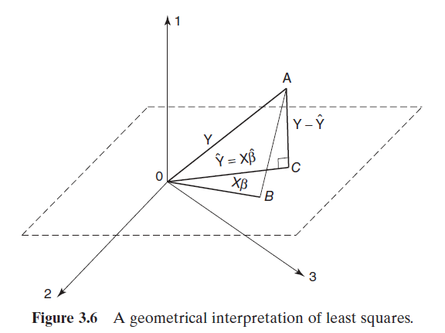

Least squares normal equations Geometrical Interpretation
$y−\hat{y}=y−X\hat{β}$ is perpendicular to the estimation space, $Span\left(X\right)$
$X^{′}\left(y−X\hat{β}\right)=0$ or $X^{′}X\hat{β}=X^{′}y$
M

Slide 17
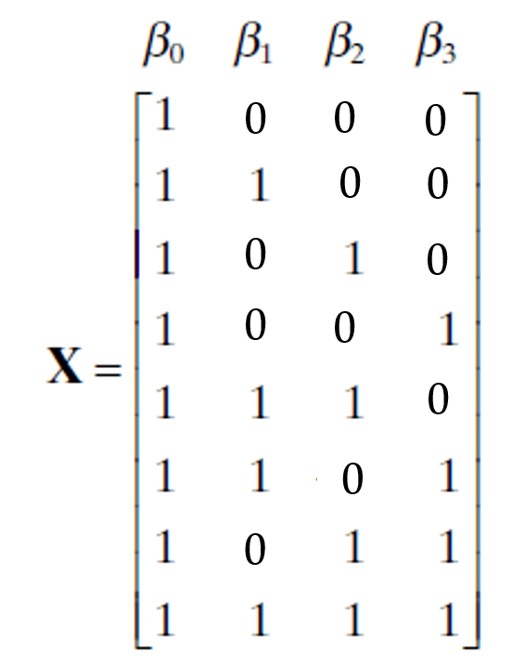
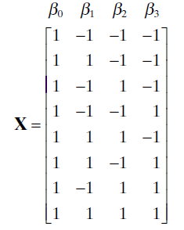
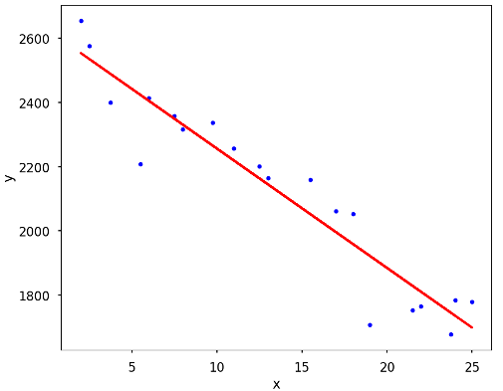
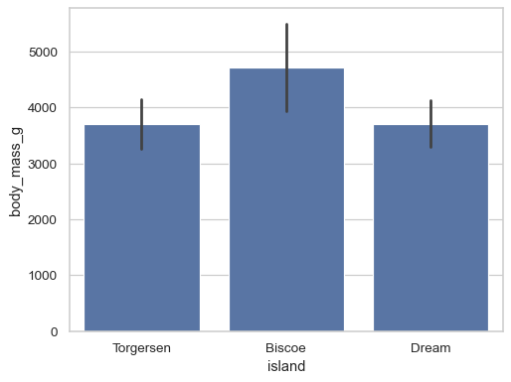

Special case of orthogonal columns
Linear Models:
Linear regression and ANOVA model ($2^{k}$ design)
Example: A categorical variable has 4 different classes
Linear Regression | ANOVA (Orthogonal)
M

Slide 18
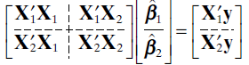
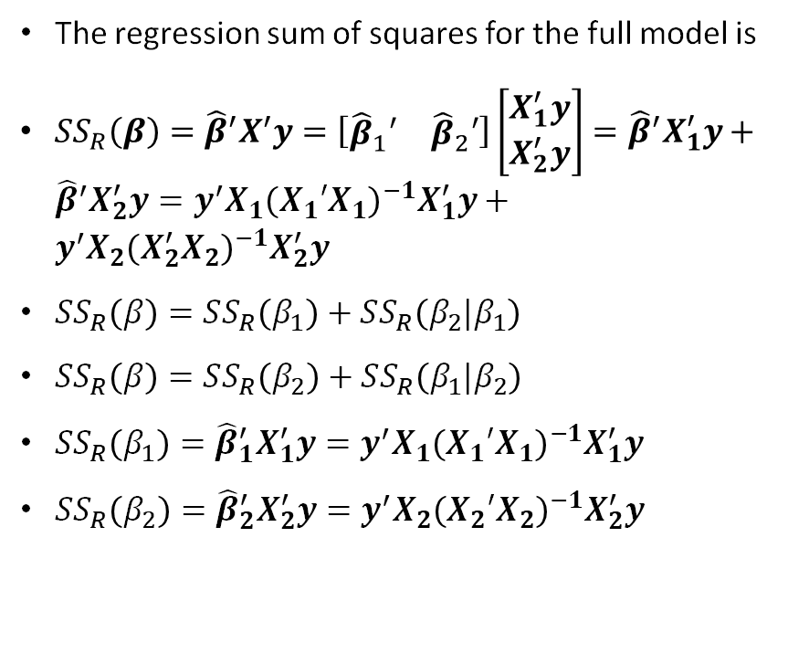
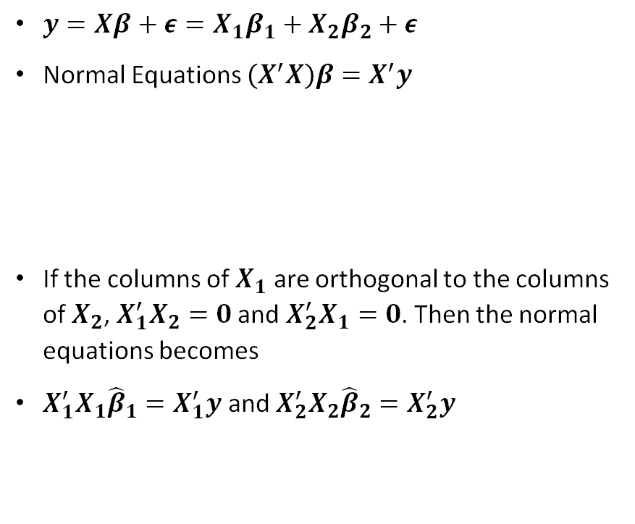
Special case of orthogonal columns
$y=Xβ+ε=X_{1}β_{1}+X_{2}β_{2}+ε$
Normal Equations $\left(X^{′}X\right)β=X^{′}y$
If the columns of $X_{1}$ are orthogonal to the columns of $X_{2}$, $X_{1}^{′}X_{2}=0$ and $X_{2}^{′}X_{1}=0$. Then the normal equations becomes
$X_{1}^{′}X_{1}{\hat{β}}_{1}=X_{1}^{′}y$ and $X_{2}^{′}X_{2}{\hat{β}}_{2}=X_{2}^{′}y$
The regression sum of squares for the full model is
$SS_{R}\left(β\right)={\hat{β}}^{′}X^{′}y=\left[\begin{matrix}{\hat{β}}_{1}′ & {\hat{β}}_{2}′\end{matrix}\right]\left[\begin{matrix}X_{1}^{′}y \\ X_{2}^{′}y\end{matrix}\right]={\hat{β}}^{′}X_{1}^{′}y+{\hat{β}}^{′}X_{2}^{′}y=y^{′}X_{1}{\left(X_{1}′X_{1}\right)}^{−1}X_{1}^{′}y+y^{′}X_{2}{\left(X_{2}^{′}X_{2}\right)}^{−1}X_{2}^{′}y$
$SS_{R}\left(β\right)=SS_{R}\left(β_{1}\right)+SS_{R}\left(β_{2}|β_{1}\right)$
$SS_{R}\left(β\right)=SS_{R}\left(β_{2}\right)+SS_{R}\left(β_{1}|β_{2}\right)$
$SS_{R}\left(β_{1}\right)={\hat{β}}_{1}^{′}X_{1}^{′}y=y^{′}X_{1}{\left(X_{1}′X_{1}\right)}^{−1}X_{1}^{′}y$
$SS_{R}\left(β_{2}\right)={\hat{β}}_{2}^{′}X_{2}^{′}y=y^{′}X_{2}{\left(X_{2}′X_{2}\right)}^{−1}X_{2}^{′}y$
Unconditional Sum of Squares:$SS_{R}\left(β_{1}|β_{2}\right)=SS_{R}\left(β\right)−SS_{R}\left(β_{2}\right)≡SS_{R}\left(β_{1}\right)$
$SS_{R}\left(β_{2}|β_{1}\right)=SS_{R}\left(β\right)−SS_{R}\left(β_{1}\right)≡SS_{R}\left(β_{2}\right)$
M

Slide 19
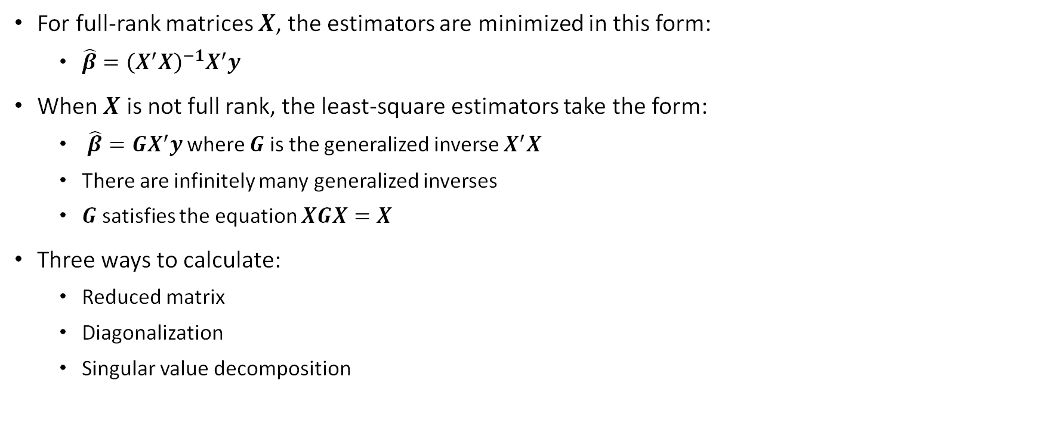
Generalized inverse
For full-rank matrices $X$, the estimators are minimized in this form:
$\hat{β}={\left(X^{′}X\right)}^{−1}X^{′}y$
When $X$ is not full rank, the least-square estimators take the form:
$\hat{β}=GX^{′}y$ where $G$ is the generalized inverse $X^{′}X$
There are infinitely many generalized inverses
$G$ satisfies the equation $XGX=X$
Three ways to calculate:
Reduced matrix
Diagonalization
Singular value decomposition
L

Slide 20
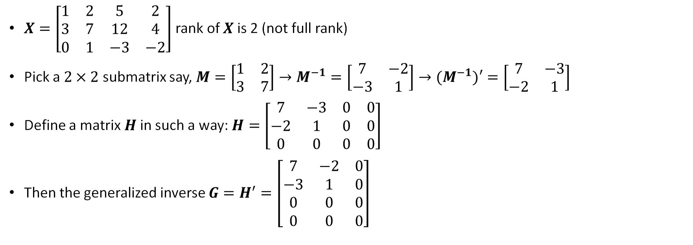
Generalized inverse example WITH REDUCED a MATRIX
$X=\left[\begin{matrix}1 & 2 & 5 & 2 \\ 3 & 7 & 12 & 4 \\ 0 & 1 & −3 & −2\end{matrix}\right]$ rank of $X$ is 2 (not full rank)
Pick a $2×2$ submatrix say, $M=\left[\begin{matrix}1 & 2 \\ 3 & 7\end{matrix}\right]→M^{−1}=\left[\begin{matrix}7 & −2 \\ −3 & 1\end{matrix}\right]→{(M}^{−1})′=\left[\begin{matrix}7 & −3 \\ −2 & 1\end{matrix}\right]$
Define a matrix $H$ in such a way: $H=\left[\begin{matrix}7 & −3 & 0 & 0 \\ −2 & 1 & 0 & 0 \\ 0 & 0 & 0 & 0\end{matrix}\right]$
Then the generalized inverse $G=H^{′}=\left[\begin{matrix}7 & −2 & 0 \\ −3 & 1 & 0 \\ 0 & 0 & 0 \\ 0 & 0 & 0\end{matrix}\right]$
L

Slide 21
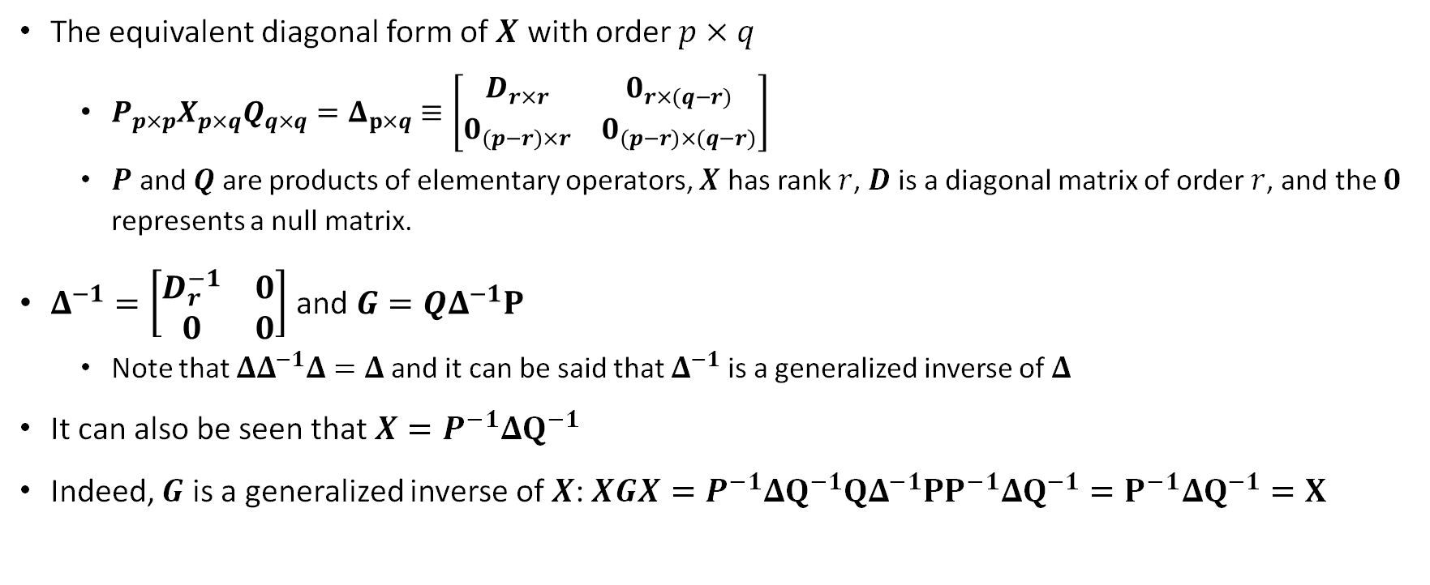
Generalized inverse - diagonalization
The equivalent diagonal form of $X$ with order $p×q$
$P_{p×p}X_{p×q}Q_{q×q}=Δ_{p×q}≡\left[\begin{matrix}D_{r×r} & 0_{r×(q−r)} \\ 0_{(p−r)×r} & 0_{(p−r)×(q−r)}\end{matrix}\right]$
$P$ and $Q$ are products of elementary operators, $X$ has rank $r$, $D$ is a diagonal matrix of order $r$, and the $0$ represents a null matrix.
$Δ^{−1}=\left[\begin{matrix}D_{r}^{−1} & 0 \\ 0 & 0\end{matrix}\right]$ and $G=QΔ^{−1}P$
Note that $ΔΔ^{−1}Δ=Δ$ and it can be said that $Δ^{−1}$ is a generalized inverse of $Δ$
It can also be seen that $X=P^{−1}ΔQ^{−1}$
Indeed, $G$ is a generalized inverse of $X$: $XGX=P^{−1}ΔQ^{−1}QΔ^{−1}PP^{−1}ΔQ^{−1}=P^{−1}ΔQ^{−1}=X$
M

Slide 22

Generalized inverse example WITH Matrix Diagonalization
$X=\left[\begin{matrix}4 & 1 & 2 & 0 \\ 1 & 1 & 5 & 15 \\ 3 & 1 & 3 & 5\end{matrix}\right]$ $P=\left[\begin{matrix}0 & 1 & 0 \\ 1 & −4 & 0 \\ −\frac{2}{3} & −\frac{1}{3} & 1\end{matrix}\right]$ $Q=\left[\begin{matrix}1 & −1 & 1 & 5 \\ 0 & 1 & −6 & −20 \\ 0 & 0 & 1 & 0 \\ 0 & 0 & 0 & 1\end{matrix}\right]$
$PXQ=Δ=\left[\begin{matrix}1 & 0 & 0 & 0 \\ 0 & −3 & 0 & 0 \\ 0 & 0 & 0 & 0\end{matrix}\right]$ $Δ^{−1}=\left[\begin{matrix}1 & 0 & 0 \\ 0 & −\frac{1}{3} & 0 \\ 0 & 0 & 0 \\ 0 & 0 & 0\end{matrix}\right]$
$G=QΔP^{−1}=\left[\begin{matrix}\frac{1}{3} & −\frac{1}{3} & 0 \\ −\frac{1}{3} & \frac{4}{3} & 0 \\ 0 & 0 & 0 \\ 0 & 0 & 0\end{matrix}\right]$
M

Slide 23
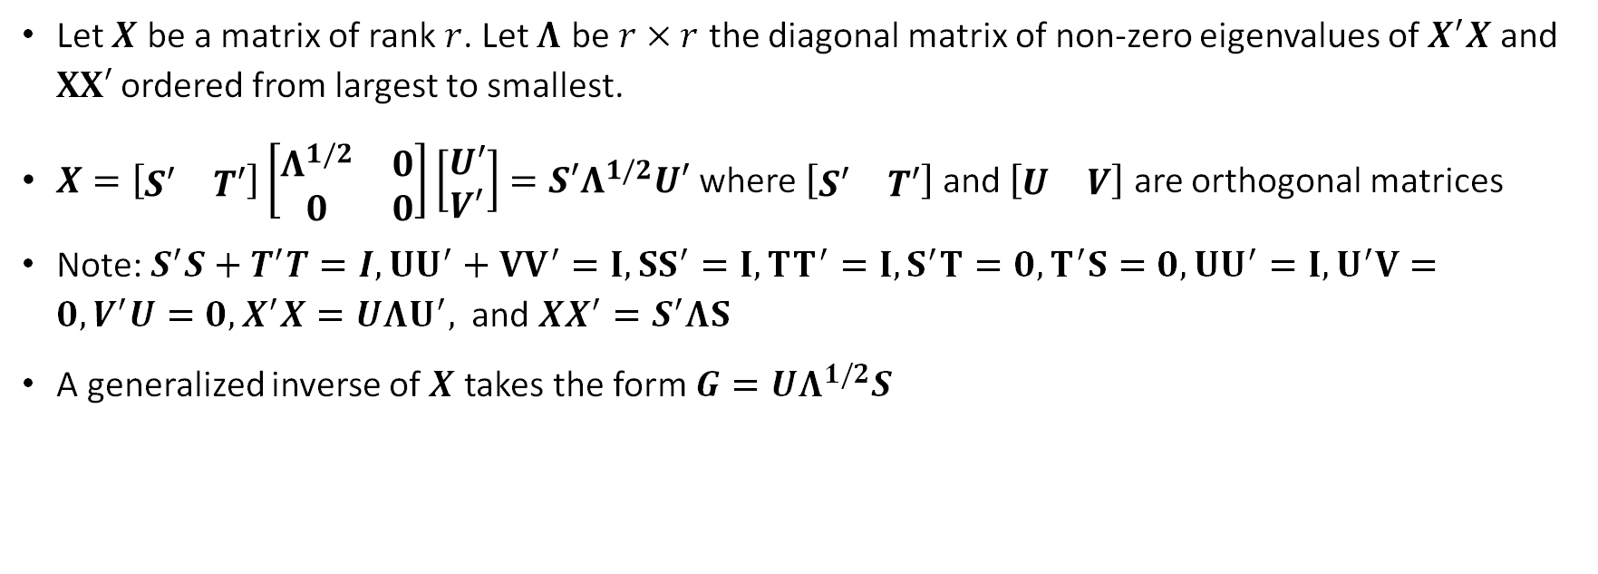
Generalized inverses using singular value decomposition
Let $X$ be a matrix of rank $r$. Let $Λ$ be $r×r$ the diagonal matrix of non-zero eigenvalues of $X^{′}X$ and $XX′$ ordered from largest to smallest.
$X=\left[\begin{matrix}S′ & T′\end{matrix}\right]\left[\begin{matrix}Λ^{1/2} & 0 \\ 0 & 0\end{matrix}\right]\left[\begin{matrix}U′ \\ V′\end{matrix}\right]=S′Λ^{1/2}U′$ where $\left[\begin{matrix}S′ & T′\end{matrix}\right]$ and $\left[\begin{matrix}U & V\end{matrix}\right]$ are orthogonal matrices
Note: $S^{′}S+T^{′}T=I, UU^{′}+VV^{′}=I, SS^{′}=I, TT^{′}=I, S^{′}T=0, T^{′}S=0, UU^{′}=I, U^{′}V=0, V^{′}U=0, X^{′}X=UΛU^{′},$ and $XX^{′}=S^{′}ΛS$
A generalized inverse of $X$ takes the form $G=UΛ^{1/2}S$
V

Slide 24
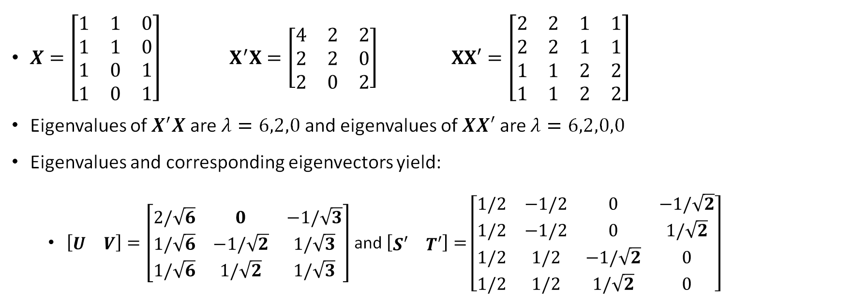
Generalized inverses using singular value decomposition example
$X=\left[\begin{matrix}1 & 1 & 0 \\ 1 & 1 & 0 \\ 1 & 0 & 1 \\ 1 & 0 & 1\end{matrix}\right]$ $X^{′}X=\left[\begin{matrix}4 & 2 & 2 \\ 2 & 2 & 0 \\ 2 & 0 & 2\end{matrix}\right]$ $XX′=\left[\begin{matrix}2 & 2 & 1 & 1 \\ 2 & 2 & 1 & 1 \\ 1 & 1 & 2 & 2 \\ 1 & 1 & 2 & 2\end{matrix}\right]$
Eigenvalues of $X^{′}X$ are $λ=6,2,0$ and eigenvalues of $XX′$ are $λ=6,2,0,0$
Eigenvalues and corresponding eigenvectors yield:
$\left[\begin{matrix}U & V\end{matrix}\right]=\left[\begin{matrix}2/\sqrt{6} & 0 & −1/\sqrt{3} \\ 1/\sqrt{6} & −1/\sqrt{2} & 1/\sqrt{3} \\ 1/\sqrt{6} & 1/\sqrt{2} & 1/\sqrt{3}\end{matrix}\right]$ and $\left[\begin{matrix}S′ & T′\end{matrix}\right]=$ $\left[\begin{matrix}1/2 & −1/2 & 0 & −1/\sqrt{2} \\ 1/2 & −1/2 & 0 & 1/\sqrt{2} \\ 1/2 & 1/2 & −1/\sqrt{2} & 0 \\ 1/2 & 1/2 & 1/\sqrt{2} & 0\end{matrix}\right]$
V

Slide 25
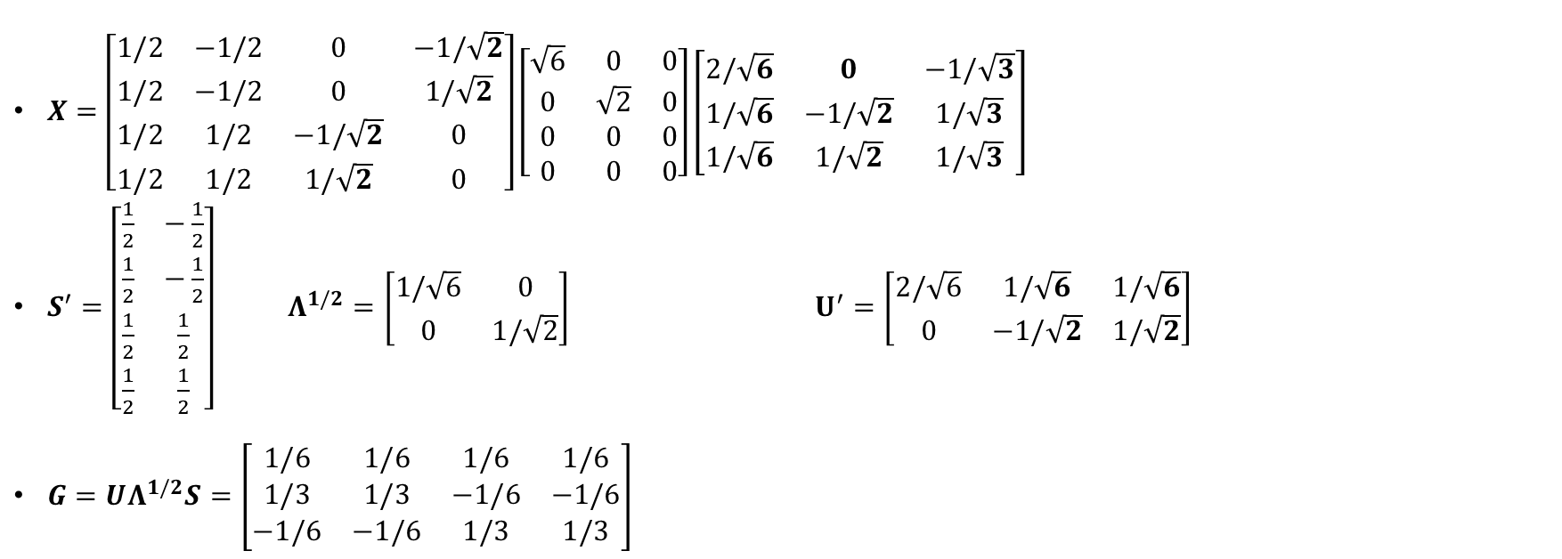
Generalized inverses using singular value decomposition example
$X=\left[\begin{matrix}1/2 & −1/2 & 0 & −1/\sqrt{2} \\ 1/2 & −1/2 & 0 & 1/\sqrt{2} \\ 1/2 & 1/2 & −1/\sqrt{2} & 0 \\ 1/2 & 1/2 & 1/\sqrt{2} & 0\end{matrix}\right]\left[\begin{matrix}\sqrt{6} & 0 & 0 \\ 0 & \sqrt{2} & 0 \\ 0 & 0 & 0 \\ 0 & 0 & 0\end{matrix}\right]\left[\begin{matrix}2/\sqrt{6} & 0 & −1/\sqrt{3} \\ 1/\sqrt{6} & −1/\sqrt{2} & 1/\sqrt{3} \\ 1/\sqrt{6} & 1/\sqrt{2} & 1/\sqrt{3}\end{matrix}\right]$
$S^{′}=\left[\begin{matrix}\frac{1}{2} & −\frac{1}{2} \\ \frac{1}{2} & −\frac{1}{2} \\ \frac{1}{2} & \frac{1}{2} \\ \frac{1}{2} & \frac{1}{2}\end{matrix}\right]$ $Λ^{1/2}=\left[\begin{matrix}1/\sqrt{6} & 0 \\ 0 & 1/\sqrt{2}\end{matrix}\right]$ $U^{′}=\left[\begin{matrix}2/\sqrt{6} & 1/\sqrt{6} & 1/\sqrt{6} \\ 0 & −1/\sqrt{2} & 1/\sqrt{2}\end{matrix}\right]$
$G=UΛ^{1/2}S=\left[\begin{matrix}1/6 & 1/6 & 1/6 & 1/6 \\ 1/3 & 1/3 & −1/6 & −1/6 \\ −1/6 & −1/6 & 1/3 & 1/3\end{matrix}\right]$
V

Slide 26
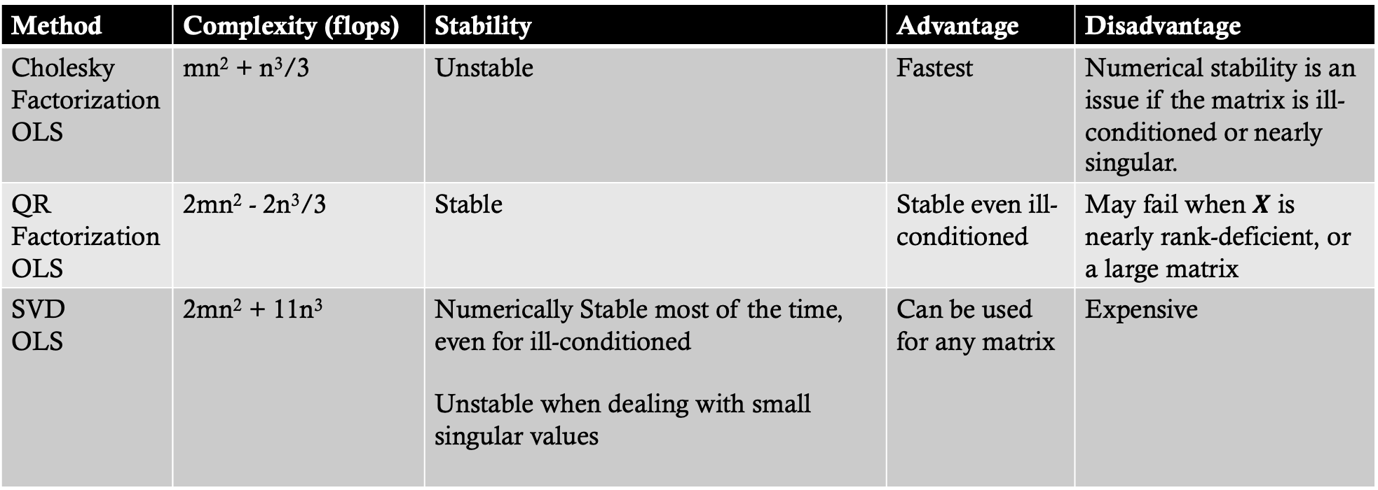
Stability and complexity of solving Least Square problem
Method | Complexity (flops) | Stability | Advantage | Disadvantage
Cholesky Factorization OLS | mn² + n³/3 | Unstable | Fastest | Numerical stability is an issue if the matrix is ill-conditioned or nearly singular.
QR Factorization OLS | 2mn² - 2n³/3 | Stable | Stable even ill-conditioned | May fail when $X$ is nearly rank-deficient, or a large matrix
SVD OLS | 2mn² + 11n³ | Numerically Stable most of the time, even for ill-conditioned Unstable when dealing with small singular values | Can be used for any matrix | Expensive
M

Slide 27
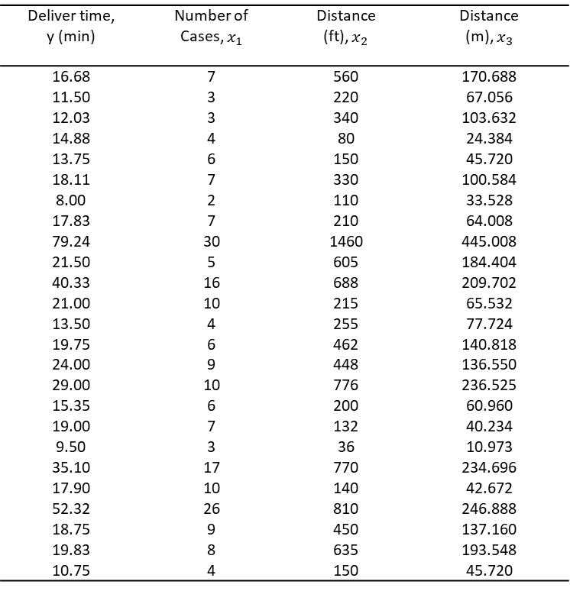
Generalized inverse example with data
Skip this
Deliver time, y (min) | Number of Cases, $x_{1}$ | Distance (ft), $x_{2}$ | Distance (m), $x_{3}$
16.68 | 7 | 560 | 170.688
11.50 | 3 | 220 | 67.056
12.03 | 3 | 340 | 103.632
14.88 | 4 | 80 | 24.384
13.75 | 6 | 150 | 45.720
18.11 | 7 | 330 | 100.584
8.00 | 2 | 110 | 33.528
17.83 | 7 | 210 | 64.008
79.24 | 30 | 1460 | 445.008
21.50 | 5 | 605 | 184.404
40.33 | 16 | 688 | 209.702
21.00 | 10 | 215 | 65.532
13.50 | 4 | 255 | 77.724
19.75 | 6 | 462 | 140.818
24.00 | 9 | 448 | 136.550
29.00 | 10 | 776 | 236.525
15.35 | 6 | 200 | 60.960
19.00 | 7 | 132 | 40.234
9.50 | 3 | 36 | 10.973
35.10 | 17 | 770 | 234.696
17.90 | 10 | 140 | 42.672
52.32 | 26 | 810 | 246.888
18.75 | 9 | 450 | 137.160
19.83 | 8 | 635 | 193.548
10.75 | 4 | 150 | 45.720

Slide 28
jax
pip install jax jaxlib
Apple_Open | Apple-Close | Apple-Volume | Adj_Close
42.76250 | 42.35750 | 83973600.00000 | 40.82956
42.52500 | 42.72250 | 89134000.00000 | 41.18138
42.84750 | 42.54500 | 89960800.00000 | 41.01028
42.42750 | 42.70000 | 87342800.00000 | 41.15970
42.81250 | 42.60500 | 98507200.00000 | 41.06812
42.42750 | 42.73250 | 75891200.00000 | 41.19102
42.79750 | 43.00750 | 104457600.00000 | 41.45611
42.95000 | 42.76500 | 68998800.00000 | 41.22237
42.89500 | 43.24250 | 75652800.00000 | 41.68262
43.54000 | 43.55750 | 87493600.00000 | 41.98626
43.42750 | 43.58250 | 68280800.00000 | 42.01036
43.30250 | 43.71750 | 111341600.00000 | 42.14049
43.58000 | 43.28750 | 112861600.00000 | 41.72601
43.57000 | 43.74250 | 103544800.00000 | 42.16460
43.92250 | 43.96250 | 109744800.00000 | 42.37665

Slide 29
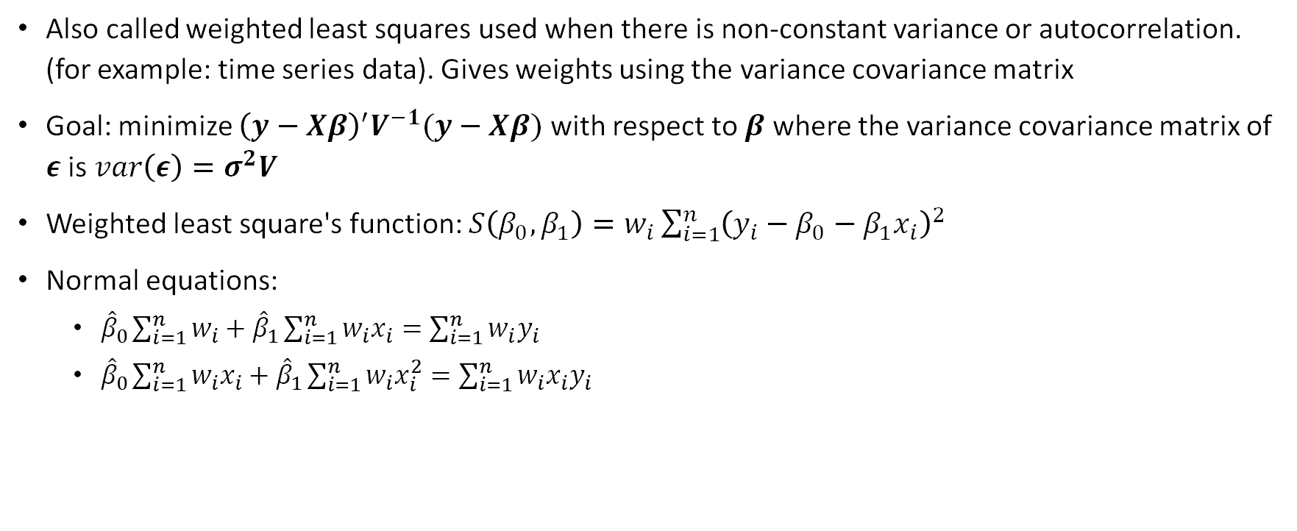
Generalized least squares
Also called weighted least squares used when there is non-constant variance or autocorrelation. (for example: time series data). Gives weights using the variance covariance matrix
Goal: minimize ${\left(y−Xβ\right)}^{′}V^{−1}(y−Xβ)$ with respect to $β$ where the variance covariance matrix of $ε$ is $var\left(ε\right)=σ^{2}V$
Weighted least square's function: $S\left(β_{0},β_{1}\right)=w_{i}\sum_{i=1}^{n}{{\left(y_{i}−β_{0}−β_{1}x_{i}\right)}^{2}}$
Normal equations:
${\hat{β}}_{0}\sum_{i=1}^{n}{w_{i}}+{\hat{β}}_{1}\sum_{i=1}^{n}{w_{i}x_{i}=\sum_{i=1}^{n}{w_{i}y_{i}}}$
${\hat{β}}_{0}\sum_{i=1}^{n}{w_{i}x_{i}}+{\hat{β}}_{1}\sum_{i=1}^{n}{w_{i}x_{i}^{2}=\sum_{i=1}^{n}{w_{i}{x_{i}y}_{i}}}$
M

Slide 30
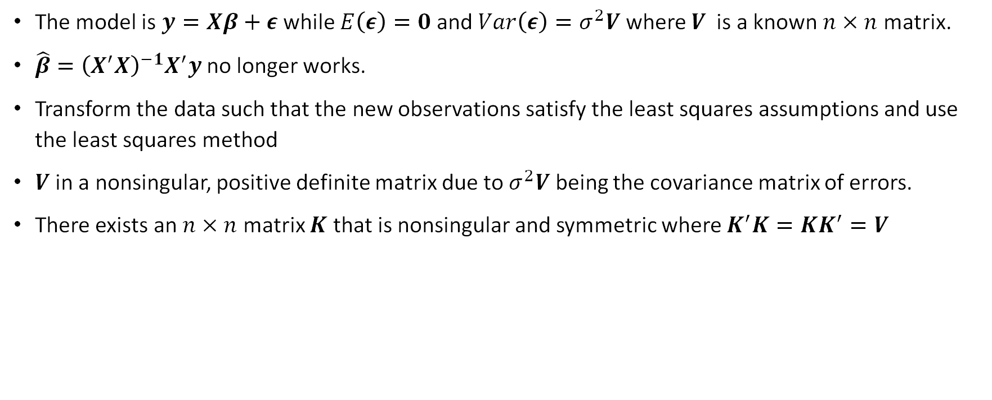
Generalized least squares
The model is $y=Xβ+ε$ while $E\left(ε\right)=0$ and $Var\left(ε\right)=σ^{2}V$ where $V$ is a known $n×n$ matrix.
$\hat{β}={\left(X^{′}X\right)}^{−1}X^{′}y$ no longer works.
Transform the data such that the new observations satisfy the least squares assumptions and use the least squares method
$V$ in a nonsingular, positive definite matrix due to $σ^{2}V$ being the covariance matrix of errors.
There exists an $n×n$ matrix $K$ that is nonsingular and symmetric where $K^{′}K=KK^{′}=V$
M

Slide 31
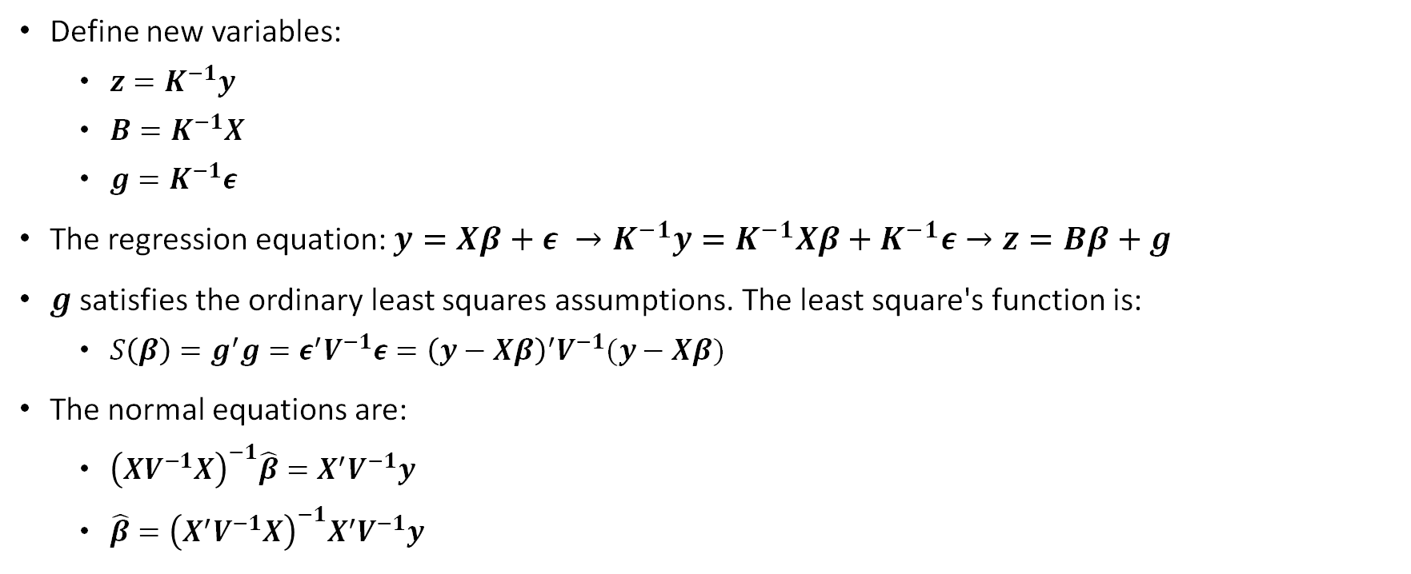
Generalized least squares
Define new variables:
$z=K^{−1}y$
$B=K^{−1}X$
$g=K^{−1}ε$
The regression equation: $y=Xβ+ε →K^{−1}y=K^{−1}Xβ+K^{−1}ε→z=Bβ+g$
$g$ satisfies the ordinary least squares assumptions. The least square's function is:
$S\left(β\right)=g^{′}g=ε^{′}V^{−1}ε={\left(y−Xβ\right)}^{′}V^{−1}(y−Xβ)$
The normal equations are:
${\left(XV^{−1}X\right)}^{−1}\hat{β}=X^{′}V^{−1}y$
$\hat{β}={\left(X^{′}V^{−1}X\right)}^{−1}X^{′}V^{−1}y$
M

Slide 32
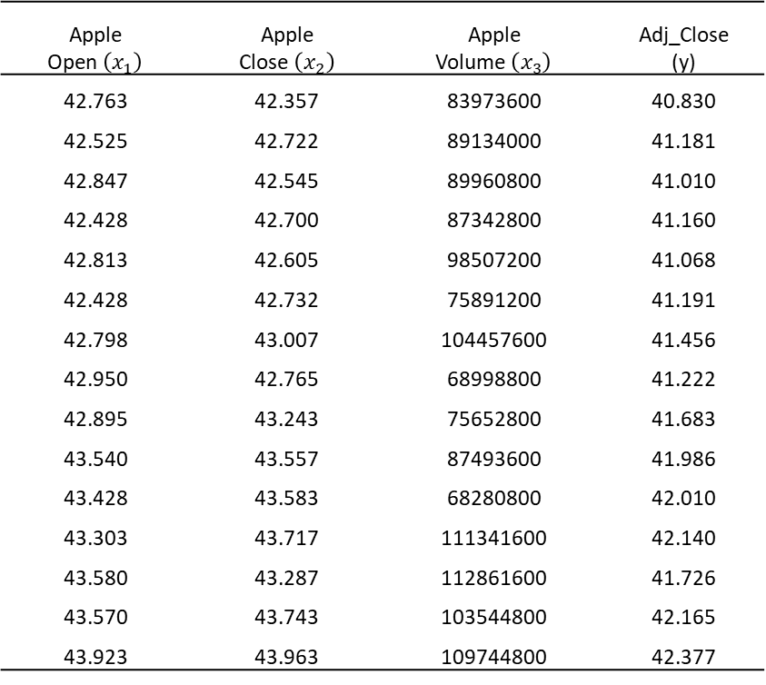
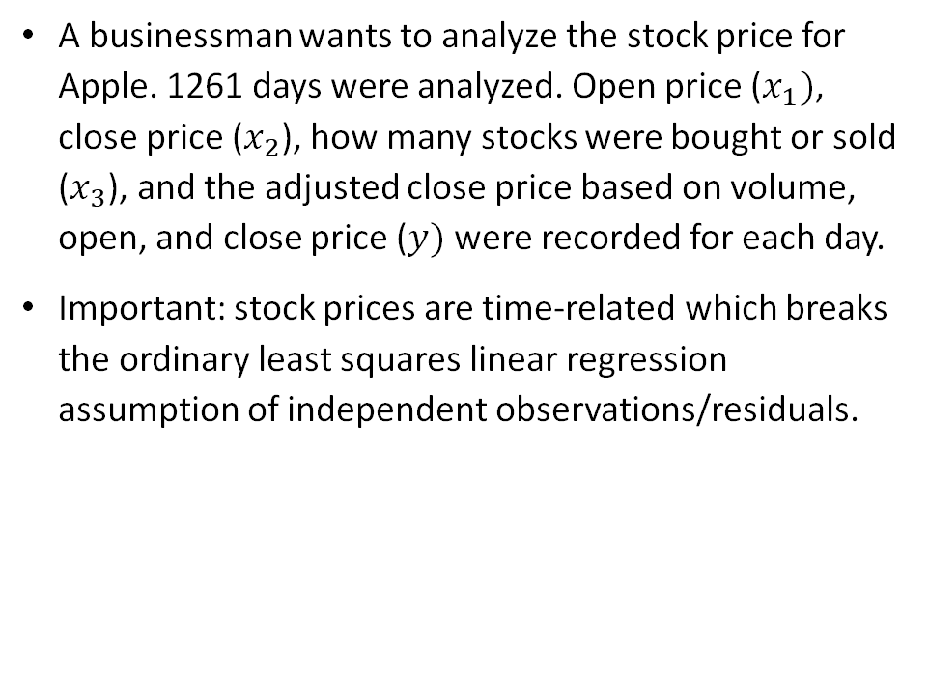
Generalized least squares example
A businessman wants to analyze the stock price for Apple. 1261 days were analyzed. Open price ($x_{1})$, close price ($x_{2}$), how many stocks were bought or sold ($x_{3}$), and the adjusted close price based on volume, open, and close price ($y)$ were recorded for each day.
Important: stock prices are time-related which breaks the ordinary least squares linear regression assumption of independent observations/residuals.
Apple Open $\left(x_{1}\right)$ | Apple Close $\left(x_{2}\right)$ | Apple Volume $\left(x_{3}\right)$ | Adj_Close (y)
42.763 | 42.357 | 83973600 | 40.830
42.525 | 42.722 | 89134000 | 41.181
42.847 | 42.545 | 89960800 | 41.010
42.428 | 42.700 | 87342800 | 41.160
42.813 | 42.605 | 98507200 | 41.068
42.428 | 42.732 | 75891200 | 41.191
42.798 | 43.007 | 104457600 | 41.456
42.950 | 42.765 | 68998800 | 41.222
42.895 | 43.243 | 75652800 | 41.683
43.540 | 43.557 | 87493600 | 41.986
43.428 | 43.583 | 68280800 | 42.010
43.303 | 43.717 | 111341600 | 42.140
43.580 | 43.287 | 112861600 | 41.726
43.570 | 43.743 | 103544800 | 42.165
43.923 | 43.963 | 109744800 | 42.377
V

Slide 33
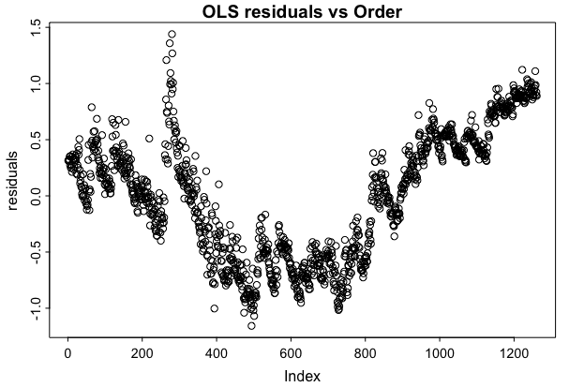
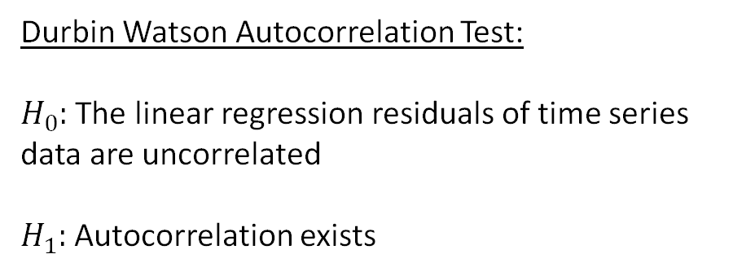
Autocorrelation Ordinary Least Squares
Durbin Watson Autocorrelation Test:
$H_{0}:$ The linear regression residuals of time series data are uncorrelated
$H_{1}:$ Autocorrelation exists
 | OLS Reg
P-value | < 2.2e-16
Conclusion | Significant Autocorrelation (positive)
V

Slide 34
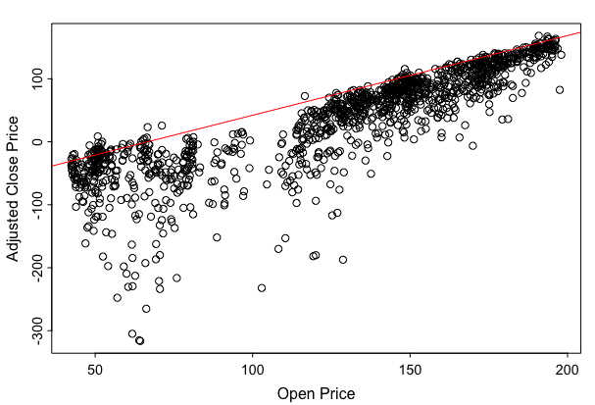
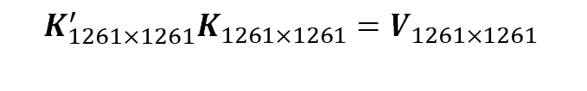
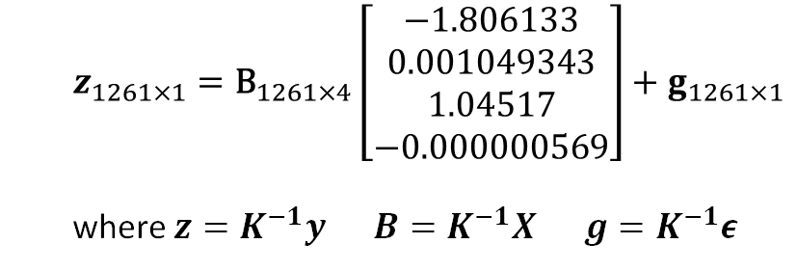
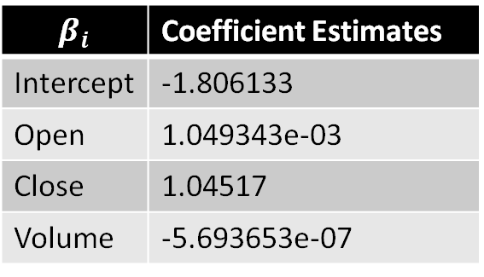
Linear Regression Model from GLS estimate
$$K_{1261×1261}^{′}K_{1261×1261}=V_{1261×1261 }$$
$$β_{i}$$ | Coefficient Estimates
Intercept | -1.806133
Open | 1.049343e-03
Close | 1.04517
Volume | -5.693653e-07
$z_{1261×1}={\text{B}}_{1261×4}\left[\begin{matrix}−1.806133 \\ 0.001049343 \\ 1.04517 \\ −0.000000569\end{matrix}\right]+g_{1261×1}$
where $z=K^{−1}y B=K^{−1}X g=K^{−1}ε$
V

Slide 35
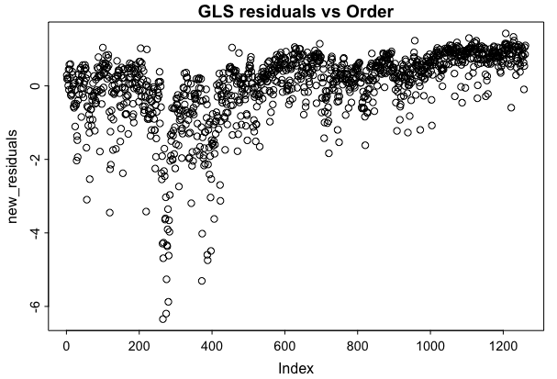
Autocorrelation Comparison
Durbin Watson Autocorrelation Test:
$H_{0}:$ The linear regression residuals of time series data are uncorrelated
$H_{1}:$ Autocorrelation exists
 | OLS Reg | GLS Reg
P-value | < 2.2e-16 | 0.7082371
Conclusion | Significant Autocorrelation (positive) | Not Significant
V

Slide 36


Generalized Least squares python code
$$\hat{y}=−1.806+0.00105x_{1}+1.0045x_{2}−3.2389e−09x_{3}$$
V

Slide 37

Condition number - Kappa
Condition number is denoted by $κ(X)$ is defined by:
$κ\left(X\right)=\left|\left|X\right|\right|\left|\left|X^{−1}\right|\right|$
If $κ$ is small, $X$ is said to be well-conditioned
If $κ$ is large, $X$ is ill-conditioned
If $X$ is singular, then $κ\left(X\right)=∞$
If $||∙||=||∙|{\left.​\right|}_{2}$, then $κ\left(X \right)=\frac{σ_{1}}{σ_{m}}$
Norm Type | Kappa
1-norm | 2131162740.203
2-norm | 523926887.709
Inf-norm | 1437589964.344
M

Slide 38

Least squares
Page 98 in linear models textbook intro to estimation of least squares and start of normal equations
Page 99 in linear models textbook example of least square fit
Page 70 in regression textbook starts least squares
Page 74 in regression textbook is an example of least square fit
Page 109 in linear models textbook starts ordinary least squares

Slide 39

Normal equations
Page 102 in linear models textbook is the normal equations formula
Page 103 in linear models textbook is an example
Page 205 in linear models textbook starts the normal equations for not full rank matrices
Example 1 is on page 206
Example 2 is on page 210

Slide 40
Generalized inverse
Page 3 in linear models textbook is the intro to GI
Page 14 in linear models textbook obtaining generalized inverses using singular value decomposition
Page 102 in linear models textbook is the application of generalized inverse for normal equations

Slide 41
generalized least squares
Page 109 in linear models textbook starts generalized least squares
Page 188 in regression textbook starts generalized least squares
Explain conditions and why we need it (for sparse matrices)
Use the same data from ordinary and then add in a made-up variable that identifies the major field so it can add in lots of 0s
SVD make from scratch? Or built in function?

Slide 42
Kappa and convergance or divergance?

